Slide 1




Evaluations of the potentiating effect
of the LPG® soins techniques
associated with Endermolift™:
Study on hemiface with 10 healthy volunteers
Professor Philippe HUMBERT
Research and Studies Center on the Integument (CERT)
Department of Dermatology, Clinical Investigation Center (CIC BT506)
Besançon University Hospital, France
INSERM UMR1098, FED4234 IBCT

Slide 2
Design of the study
INCLUSION
N=10 subjects
35 to 50
years old
With « sagging» type
BEFORE
Clinical quotations
Image analysis (fringe projection, skin imprints)
COMBINED TREATMENT
ENDERMOLIFT™
whole face
2x/week
16 sessions
+ LPG® soins techniques
on hemiface versus placebo
AFTER 2 months
Clinical quotations
Image analysis (fringe projection, skin imprints)
Self-assessment questionnaire
EVALUATIONS
EVALUATIONS

Slide 3
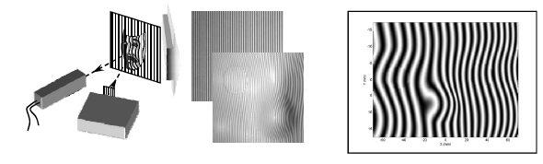
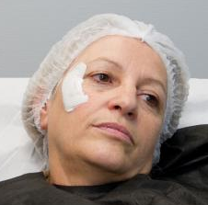
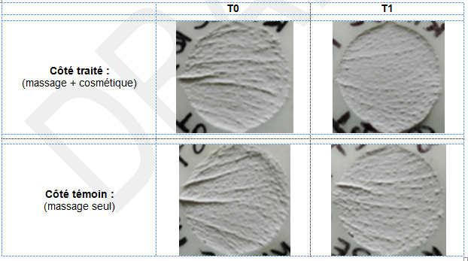
Image analysis
Fringe projection
Principle: Projecting a narrow band of light onto a three-dimensionally shaped surface produces a line of illumination that appears distorted from other perspectives than that of the projector, and can be used for an exact geometric reconstruction of the surface shape.
Skin imprints
For each subject, skin imprints are carried out with a silicone paste that hardens as it dries (Silflo®) and used to examinate skin microrelief.

Slide 4
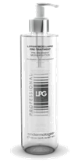
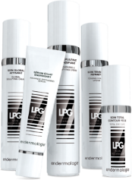
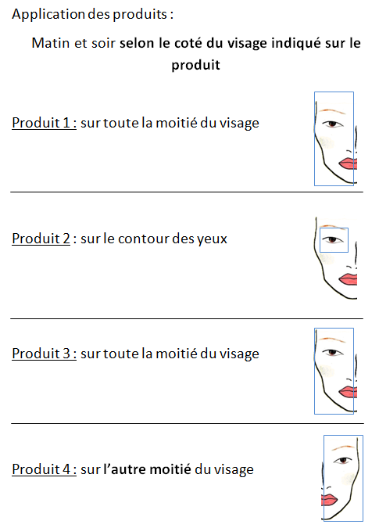

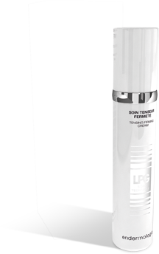
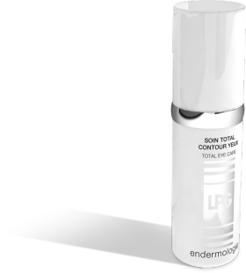
Cosmetic application
On one side of the face:
On the other side of the face:
1. RADIANCE
ENERGISING SERUM
2. TENSING
FIRMING CREAM
PLACEBO (Moisturizing base)
3. TOTAL EYE CARE
At home, morning and evening
and during each session of Endermolift™

Slide 5







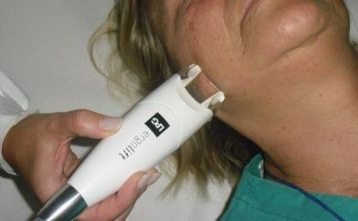
Endermolift™ treatment
« Anti-aging Firming Endermolift™ » Protocol
30min
Entire face
Twice a week
For 8 weeks = 16 sessions

Slide 6
RESULTS

Slide 7
QUESTIONNAIRES
Satisfaction*
100 % of the subjects
*Endermolift™ treatment
and efficacy of the combined treatment
Satisfaction questionnaires outline a positive feeling regarding the treatment, even greater on the side treated with LPG® Soins Techniques

Slide 8
More patients satisfied with the use of LPG® Soins Techniques compared to placebo
QUESTIONNAIRES
X 5
X 4
Number of subjects satisfied versus placebo
X 2
SATISFACTION
CRITERIA:
Lifting effect
Firmness improvement
Oval and spots improvement

Slide 9
CLINICAL QUOTATIONS
Decrease of bad color of the skin
= improvement of glowing complexion
-20%
-40%
Glowing complexion is improved on both sides of the face and this improvement is 2 times greater on the side treated with LPG® Soins Techniques

Slide 10
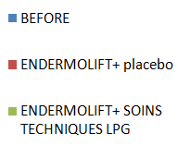
Decrease of skin surface irregularities, wrinkles/finelines and eye bags
CLINICAL QUOTATIONS
Average value of improvement
AFTER 16 sessions
-15.7%
-19.7%
-10%
-15%
-17.5%
-24.6%
-18%
-20%
SKIN SURFACE
IRREGULARITIES
WRINKLES
FINE LINES
EYE
RINGS
Skin surface irregularities, wrinkles/fine lines and eye bags are improved on both sides of the face and this improvement is greater on the side treated with LPG® Soins Techniques

Slide 11
Decrease of the signs of skin aging
CLINICAL QUOTATIONS
Average value of improvement: Comparison with Humbert study 1
-15%
-20%
BEFORE
ENDERMOLIFT
+ Placebo
(16 SESSIONS)
ENDERMOLIFT
+ SOINS TECHNIQUES
(16 SESSIONS)
HUMBERT STUDY 1 :
ENDERMOLIFT ALONE
(24 SESSIONS)

Slide 12
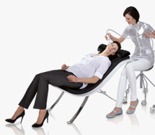
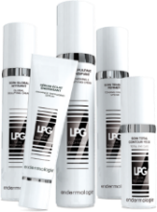
Decrease of the signs of skin aging
CLINICAL QUOTATIONS
Average value of improvement: Comparison with Humbert study 1
-15%
-20%
Comparable effect
BEFORE
ENDERMOLIFT
+ Placebo
(16 SESSIONS)
ENDERMOLIFT
+ SOINS TECHNIQUES
(16 SESSIONS)
HUMBERT STUDY 1 :
ENDERMOLIFT ALONE
(24 SESSIONS)
16
sessions
24
sessions

Slide 13
Decrease of the signs of skin aging
CLINICAL QUOTATIONS
Average value of improvement: Comparison with Humbert study 1
-15%
-20%
Comparable effect
BEFORE
ENDERMOLIFT
+ Placebo
(16 SESSIONS)
ENDERMOLIFT
+ SOINS TECHNIQUES
(16 SESSIONS)
HUMBERT STUDY 1 :
ENDERMOLIFT ALONE
(24 SESSIONS)
2
sessions
3
sessions

Slide 14
Decrease of the signs of skin aging
CLINICAL QUOTATIONS
Average value of improvement: Comparison with Humbert study 1
-15%
-20%
Comparable effect
BEFORE
ENDERMOLIFT
+ Placebo
(16 SESSIONS)
ENDERMOLIFT
+ SOINS TECHNIQUES
(16 SESSIONS)
HUMBERT STUDY 1 :
ENDERMOLIFT ALONE
(24 SESSIONS)
+ 50% efficacy
Synergy

Slide 15
SKIN IMPRINTS
Crow’s feet analysis
BEFORE
AFTER
> Side treated Endermolift™ + LPG® cosmetics
> Side treated Endermolift™ + placebo
Crow’s feet wrinkles are improved on both sides of the face and this improvement is greater on the side treated with LPG® Soins Techniques

Slide 16
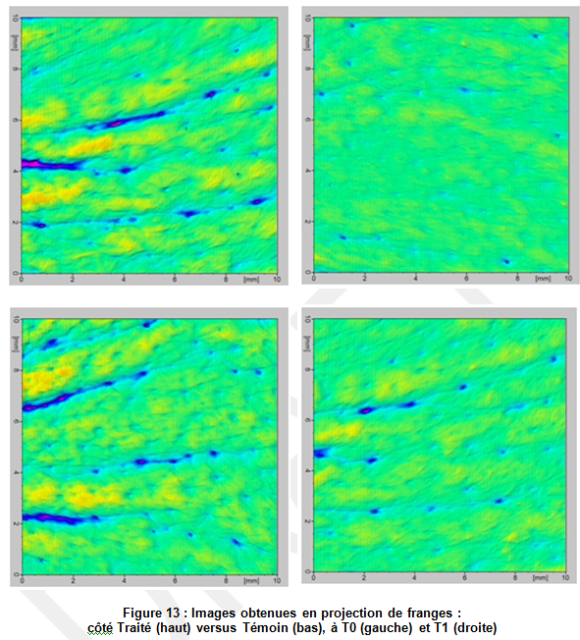
FRINGE PROJECTION
Analysis of crow’s feet
BEFORE
AFTER
> Side treated Endermolift™ + LPG® cosmetics
> Side treated Endermolift™ + placebo
Crow’s feet wrinkles are improved on both sides of the face and this improvement is greater on the side treated with LPG® Soins Techniques

Slide 17
Conclusion
The use of LPG® cosmetics strengthens the effects of Endermolift™
This potentiating effect shows significant improvement on different signs of skin aging*, microrelief and subject satisfaction
To remember:
Active ingredients of LPG® cosmetics are effective /Placebo
Thanks to the LPG® Soins Techniques :
Effect is twice greater on glowing complexion
+50% efficacy on signs of skin aging*
*Skin surface irregularities, wrinkles/fine lines and eye rings

